Slide 1
CSE 417T Introduction to Machine Learning
Lecture 20 Instructor: Chien-Ju (CJ) Ho

Slide 2
Logistics
Homework 5 is due December 2 (Friday)
Exam 2 will be on December 8 (Thursday)
Will focus on the topics in the second half of the semester
Format / logistics will be similar to Exam 1
More details to come

Slide 3
Recap

Slide 4
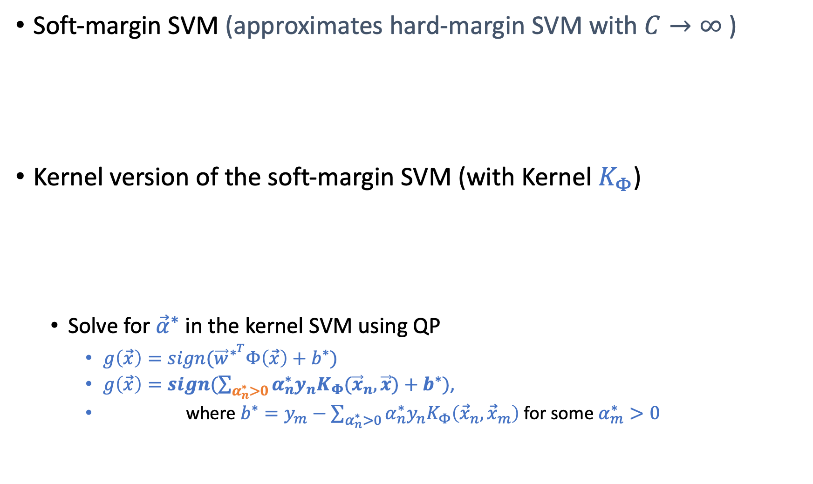
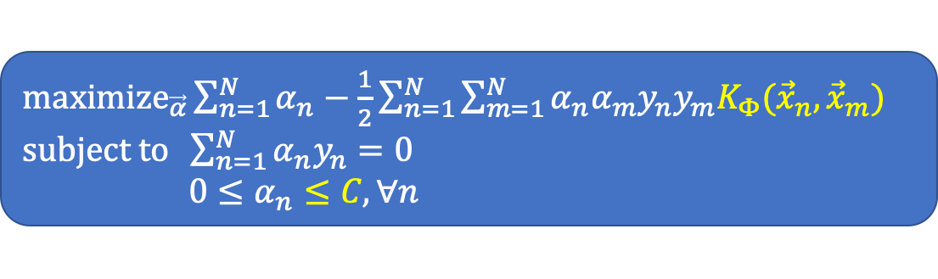
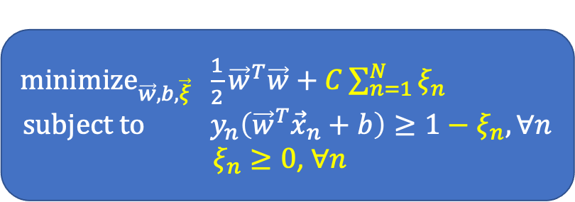
Support Vector Machines
Soft-margin SVM (approximates hard-margin SVM with $C→∞$)
Kernel version of the soft-margin SVM (with Kernel $K_{Φ}$)
Solve for ${\vec{α}}^{∗}$ in the kernel SVM using QP
$g\left(\vec{x}\right)=sign({\vec{w}}^{∗^{T}}Φ\left(\vec{x}\right)+b^{∗})$
$g\left(\vec{x}\right)=sign(\sum_{α_{n}^{∗}>0}{α_{n}^{∗}y_{n}K_{Φ}({\vec{x}}_{n},\vec{x})}+b^{∗})$,
where $b^{∗}=y_{m}−\sum_{α_{n}^{∗}>0}{α_{n}^{∗}y_{n}K_{Φ}\left({\vec{x}}_{n},{\vec{x}}_{m}\right)}$ for some $α_{m}^{∗}>0$
${\text{minimize}}_{\vec{w},b,\vec{ξ}} \frac{1}{2}{\vec{w}}^{T}\vec{w}+C\sum_{n=1}^{N}{ξ_{n}}$ $$\text{subject} \text{to} y_{n}\left({\vec{w}}^{T}{\vec{x}}_{n}+b\right)≥1−ξ_{n}, ∀n$$
$ξ_{n}≥0$, $∀n$
${\text{maximize}}_{\vec{α}}\sum_{n=1}^{N}{α_{n}}−\frac{1}{2}\sum_{n=1}^{N}{\sum_{m=1}^{N}{α_{n}α_{m}y_{n}y_{m}K_{Φ}({\vec{x}}_{n},{\vec{x}}_{m})}}$ $\text{subject} \text{to} \sum_{n=1}^{N}{α_{n}y_{n}=0}$ $0≤α_{n}≤C,∀n$

Slide 5
Neural Networks

Slide 6
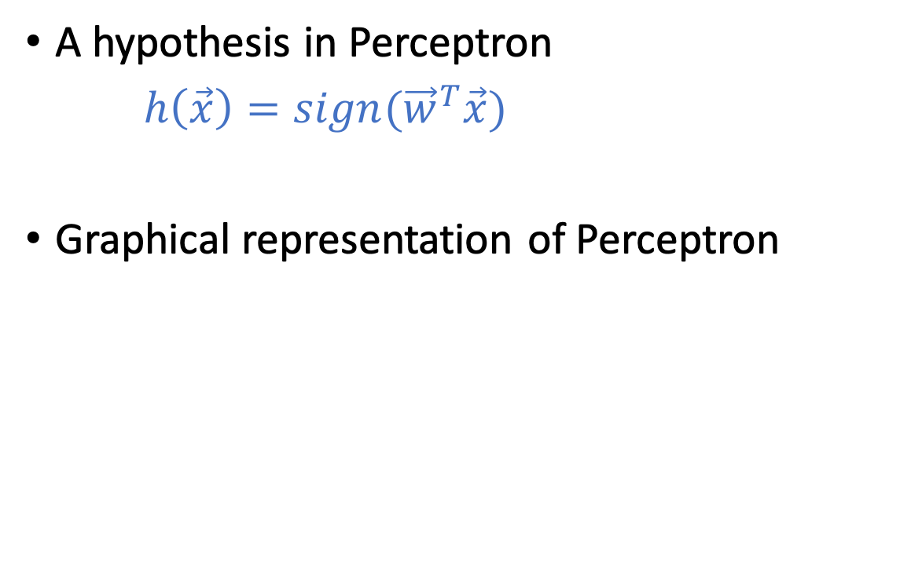
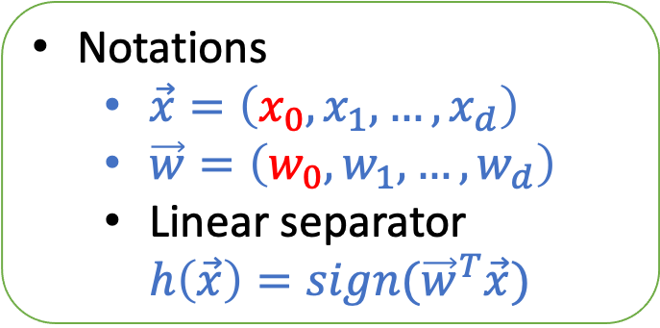
Perceptron
A hypothesis in Perceptron
$h\left(\vec{x}\right)=sign({\vec{w}}^{T}\vec{x})$
Graphical representation of Perceptron
Notations
$\vec{x}=\left(x_{0},x_{1},…,x_{d}\right)$
$\vec{w}=\left(w_{0},w_{1},…,w_{d}\right)$
Linear separator $h\left(\vec{x}\right)=sign({\vec{w}}^{T}\vec{x})$
Inspired by neurons:
The output signal is triggered when the weighted combination of the inputs is larger than some threshold

Slide 7
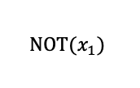
Implementing Logic Gates with Perceptron
0
-1
$$\text{NOT}(x_{1})$$
Impossible to implement XOR using a single perceptron

Slide 8
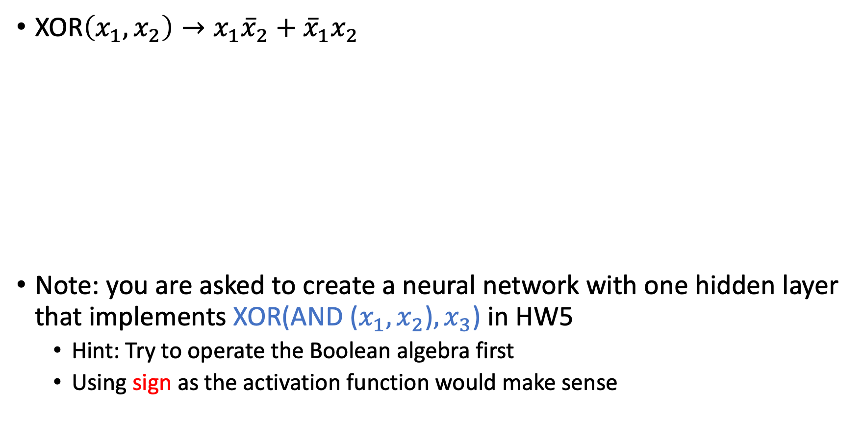
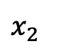
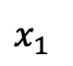
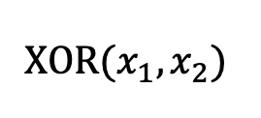
Multi-Layer Perceptron
XOR$\left(x_{1},x_{2}\right)→x_{1}{\overline{x}}_{2}+{\overline{x}}_{1}x_{2}$
Note: you are asked to create a neural network with one hidden layer that implements XOR(AND ($x_{1},x_{2}$)$,x_{3}$) in HW5
Hint: Try to operate the Boolean algebra first
Using sign as the activation function would make sense
$$\text{XOR}(x_{1},x_{2})$$
$$x_{1}$$
$$x_{2}$$

Slide 9
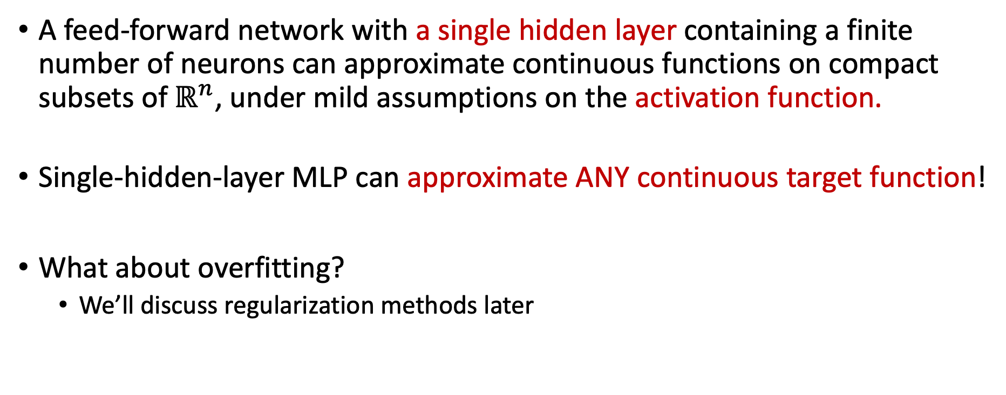
Universal Approximation Theorem
A feed-forward network with a single hidden layer containing a finite number of neurons can approximate continuous functions on compact subsets of$ℝ^{n}$, under mild assumptions on the activation function.
Single-hidden-layer MLP can approximate ANY continuous target function!
What about overfitting?
We’ll discuss regularization methods later
Notes:
Activation function – non-constant, bounded, continuous

Slide 10
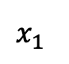
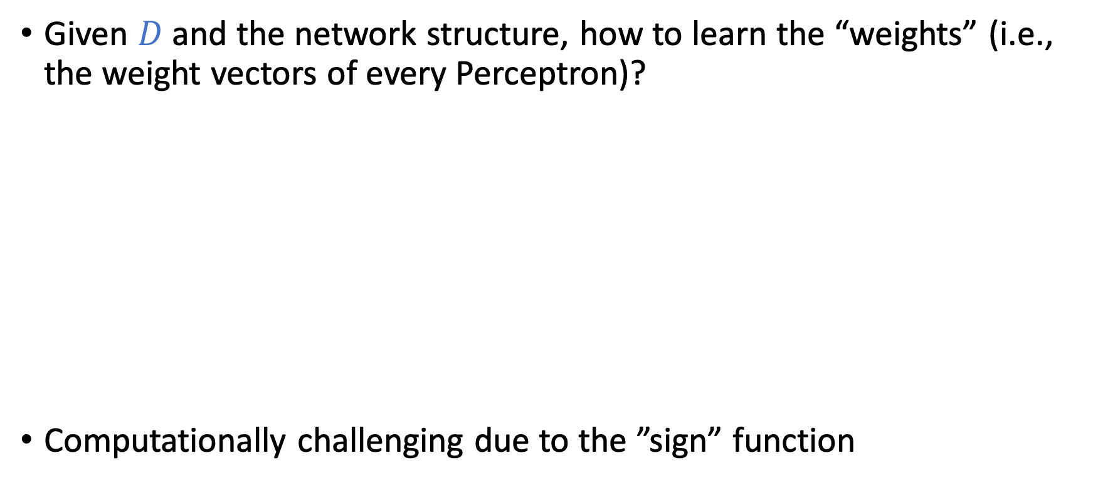
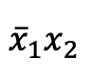
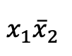
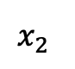
Learn MLP From Data?
Given $D$ and the network structure, how to learn the “weights” (i.e., the weight vectors of every Perceptron)?
Computationally challenging due to the ”sign” function
$$x_{1}$$
$$x_{1}{\overline{x}}_{2}$$
$$x_{2}$$
$${\overline{x}}_{1}x_{2}$$

Slide 11
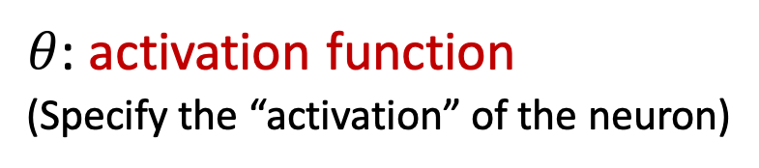
Neural Networks
A softened version of multi-layer Perceptron (MLP)
$θ$: activation function
(Specify the “activation” of the neuron)
(The activation function in the output layer is often separately considered)

Slide 12
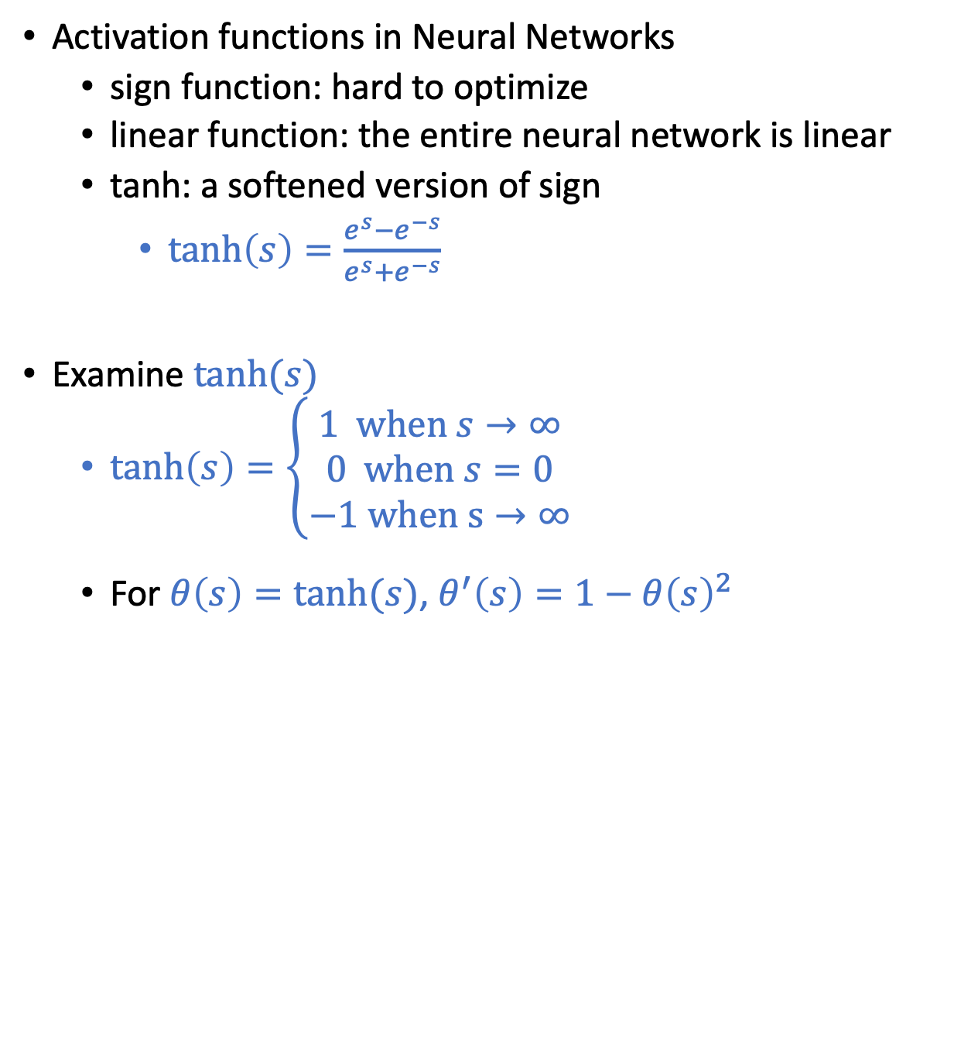
Activation Function
Activation functions in Neural Networks
sign function: hard to optimize
linear function: the entire neural network is linear
tanh: a softened version of sign
$\tanh\left(s\right)=\frac{e^{s}−e^{−s}}{e^{s}+e^{−s}}$
Examine $\tanh{(s)}$
$\tanh\left(s\right)=\left\{\begin{aligned}1 \text{when} s→∞ \\ 0 \text{when} s=0 \\ −1 \text{when} \text{s}→∞\end{aligned}\right.$
For $θ\left(s\right)=tanh⁡(s)$, $θ^{′}\left(s\right)=1−θ{\left(s\right)}^{2}$

Slide 13
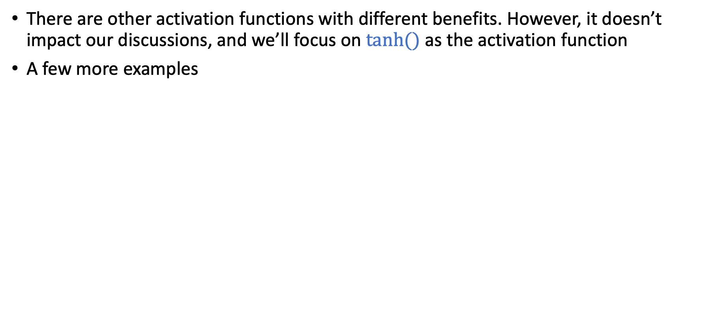
Activation Function
There are other activation functions with different benefits. However, it doesn’t impact our discussions, and we’ll focus on $tanh⁡()$ as the activation function
A few more examples
https://towardsdatascience.com/activation-functions-neural-networks-1cbd9f8d91d6

Slide 14
Today’s Lecture
The notes are not intended to be comprehensive. They should be accompanied by lectures and/or textbook.
Let me know if you spot errors.
Notes:
This is the lecture I wish I have 6 chalkboards to utilize

Slide 15
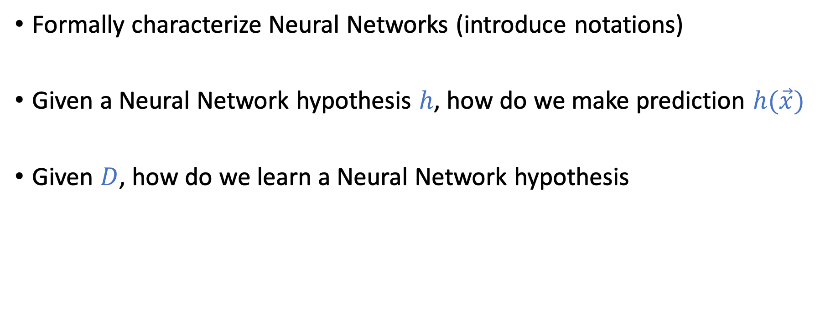
Goal of Today
Formally characterize Neural Networks (introduce notations)
Given a Neural Network hypothesis $h$, how do we make prediction $h(\vec{x})$
Given $D$, how do we learn a Neural Network hypothesis

Slide 16
Notations of Neural Networks (NN)

Slide 17
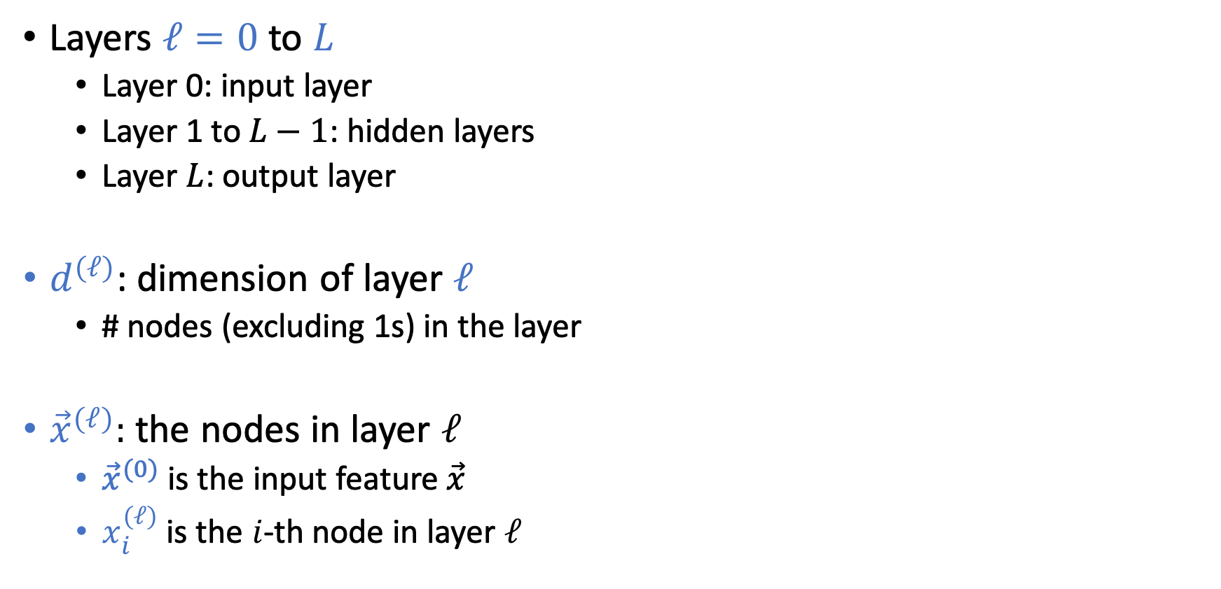
Notations of Neural Networks (NN)
Layers $ℓ=0$ to $L$
Layer 0: input layer
Layer 1 to $L−1$: hidden layers
Layer $L$: output layer
$d^{(ℓ)}$: dimension of layer $ℓ$
# nodes (excluding 1s) in the layer
${\vec{x}}^{(ℓ)}:$ the nodes in layer $ℓ$
${\vec{x}}^{(0)}$ is the input feature $\vec{x}$
$x_{i}^{(ℓ)}$ is the $i$-th node in layer $ℓ$

Slide 18
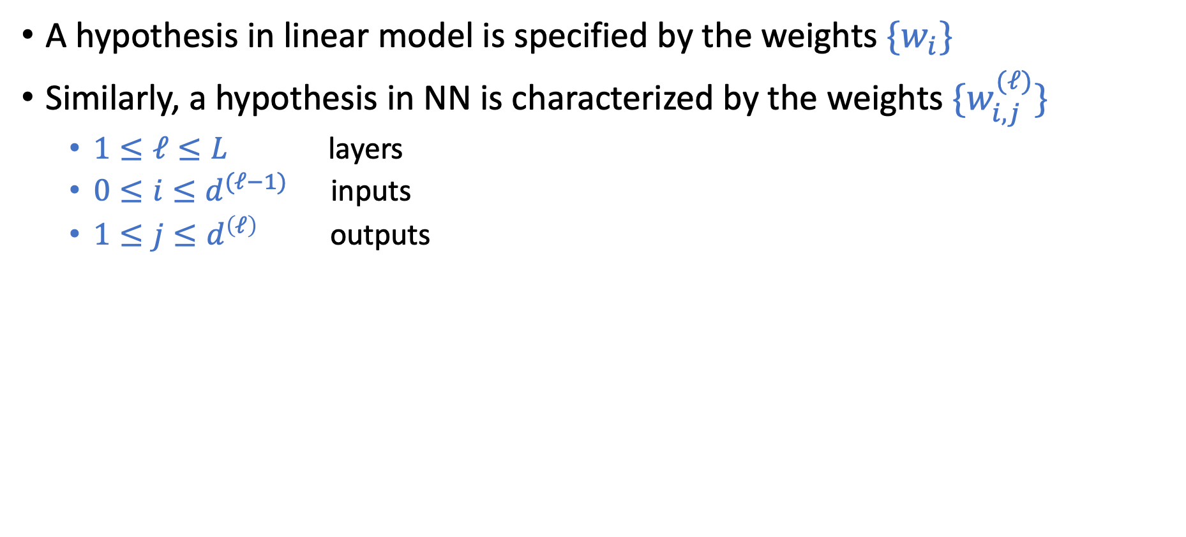
Notations of Neural Networks (NN)
A hypothesis in linear model is specified by the weights $\{w_{i}\}$
Similarly, a hypothesis in NN is characterized by the weights ${\{w}_{i,j}^{(ℓ)}\}$
$1≤ℓ≤L$ layers
$0≤i≤d^{(ℓ−1)}$ inputs
$1≤j≤d^{\left(ℓ\right)}$ outputs
Notes:
4x2 + 3x1 = 11

Slide 19
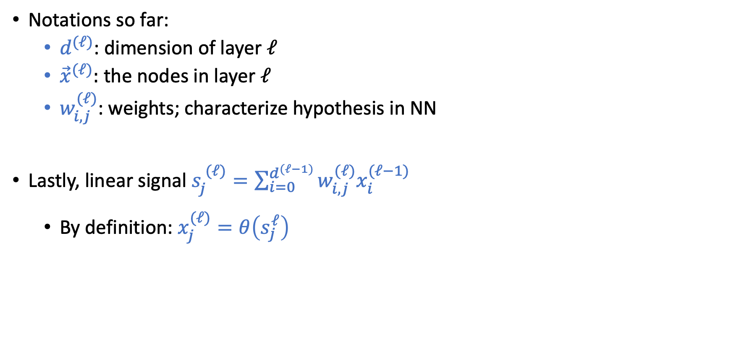
Notations of Neural Networks (NN)
Notations so far:
$d^{(ℓ)}$: dimension of layer $ℓ$
${\vec{x}}^{(ℓ)}:$ the nodes in layer $ℓ$
$w_{i,j}^{(ℓ)}$: weights; characterize hypothesis in NN
Lastly, linear signal $s_{j}^{ (ℓ)}=\sum_{i=0}^{d^{(ℓ−1)}}{w_{i,j}^{(ℓ)}x_{i}^{(ℓ−1)}}$
By definition: $x_{j}^{(ℓ)}=θ\left(s_{j}^{ℓ}\right)$
Notes:
4x2 + 3x1 = 11

Slide 20
Notations of Neural Networks (NN)
Notations so far:
$d^{(ℓ)}$: dimension of layer $ℓ$
${\vec{x}}^{(ℓ)}:$ the nodes in layer $ℓ$
$w_{i,j}^{(ℓ)}$: weights; characterize hypothesis in NN
Lastly, linear signal $s_{j}^{ (ℓ)}=\sum_{i=0}^{d^{(ℓ−1)}}{w_{i,j}^{(ℓ)}x_{i}^{(ℓ−1)}}$
By definition: $x_{j}^{(ℓ)}=θ\left(s_{j}^{ℓ}\right)$
Notes:
4x2 + 3x1 = 11

Slide 21

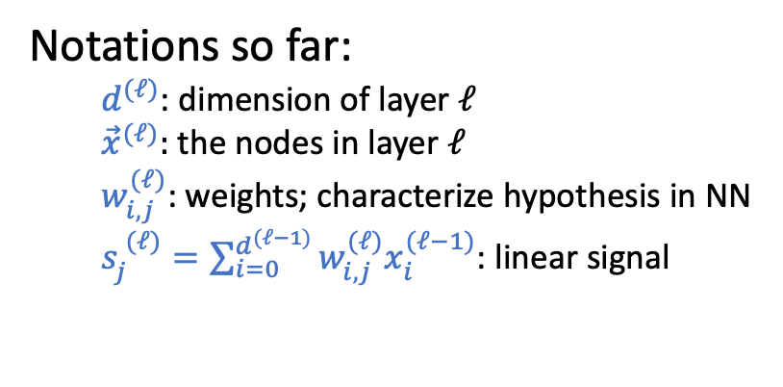
Short Break and Q&A
Practice:
For a neural network with $L=2$, $d^{(0)}=3$, $d^{(1)}=2$, $d^{(2)}=1,$ what is the total # weights?
Notations so far:
$d^{(ℓ)}$: dimension of layer $ℓ$
${\vec{x}}^{(ℓ)}:$ the nodes in layer $ℓ$
$w_{i,j}^{(ℓ)}$: weights; characterize hypothesis in NN
$s_{j}^{ (ℓ)}=\sum_{i=0}^{d^{(ℓ−1)}}{w_{i,j}^{(ℓ)}x_{i}^{(ℓ−1)}}$: linear signal
Notes:
$$4×2+3×1=11$$

Slide 22

Forward Propagation
Backpropagation
Given a NN hypothesis and a point $\vec{x}$, how do we make predictions
Learn a Neural Network hypothesis from data

Slide 23
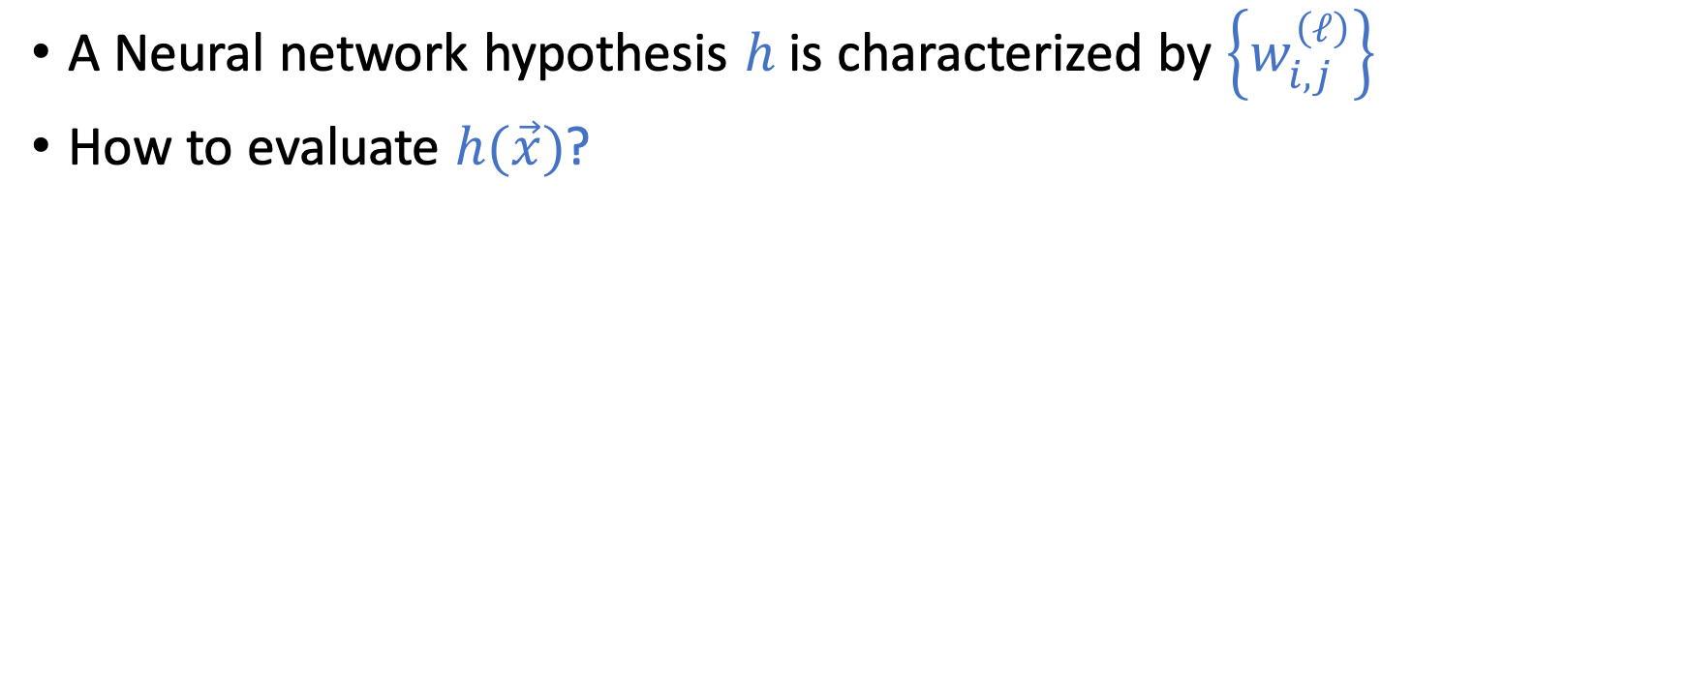
Forward Propagation
A Neural network hypothesis $h$ is characterized by $\left\{w_{i,j}^{\left(ℓ\right)}\right\}$
How to evaluate $h(\vec{x})$?

Slide 24
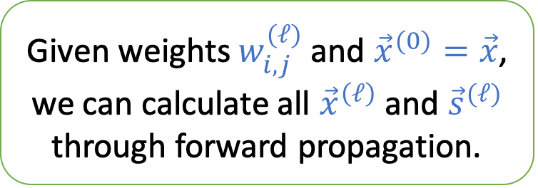
Forward Propagation
A Neural network hypothesis $h$ is characterized by $\left\{w_{i,j}^{\left(ℓ\right)}\right\}$
How to evaluate $h(\vec{x})$?
Given weights $w_{i,j}^{(ℓ)}$ and ${\vec{x}}^{(0)}=\vec{x}$, we can calculate all ${\vec{x}}^{\left(ℓ\right)}$ and ${\vec{s}}^{(ℓ)}$ through forward propagation.

Slide 25
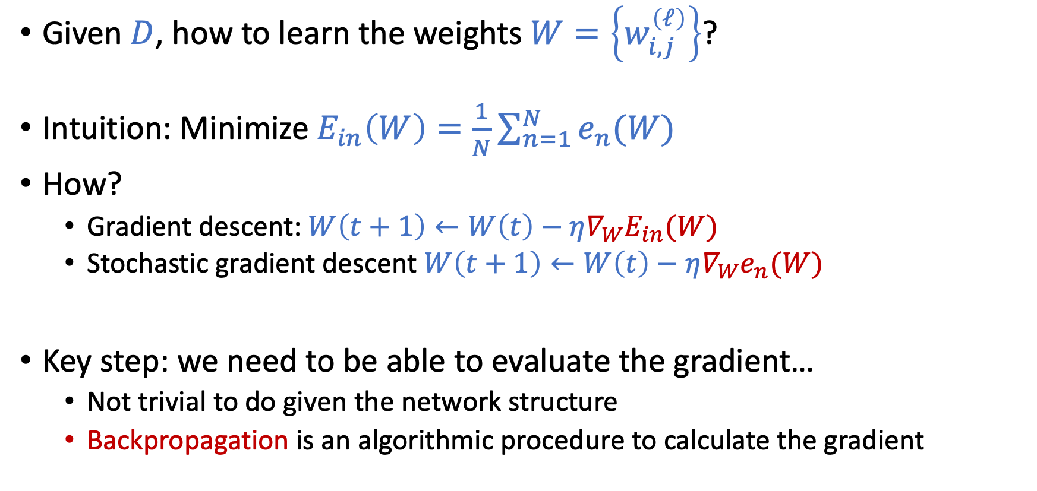
How to Learn NN From Data?
Given $D$, how to learn the weights $W=\left\{w_{i,j}^{\left(ℓ\right)}\right\}$?
Intuition: Minimize $E_{in}\left(W\right)=\frac{1}{N}\sum_{n=1}^{N}{e_{n}(W)}$
How?
Gradient descent: $W\left(t+1\right)←W\left(t\right)−η∇_{W}E_{in}(W)$
Stochastic gradient descent $W\left(t+1\right)←W\left(t\right)−η∇_{W}e_{n}(W)$
Key step: we need to be able to evaluate the gradient…
Not trivial to do given the network structure
Backpropagation is an algorithmic procedure to calculate the gradient

Slide 26
Backpropagation
Use dynamic programming to evaluate the gradient

Slide 27
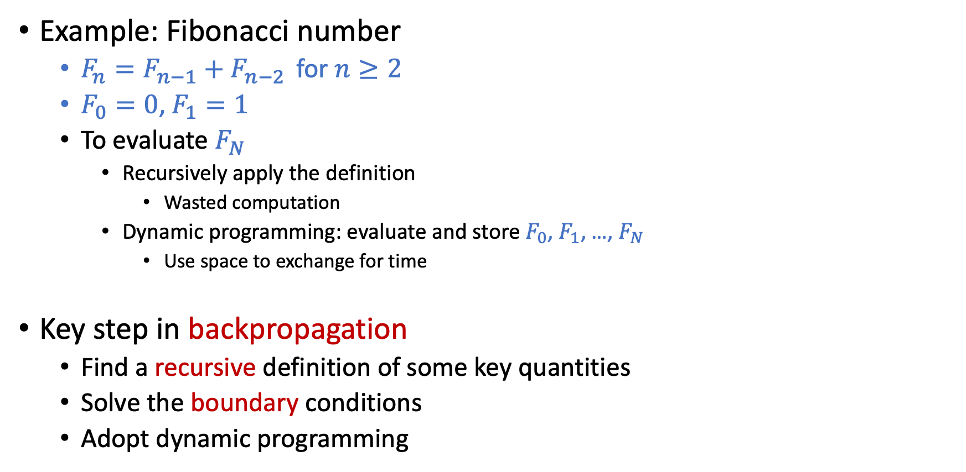
Quick Reminders on Dynamic Programming
Example: Fibonacci number
$F_{n}=F_{n−1}+F_{n−2 }$ for $n≥2$
$F_{0}=0$, $F_{1}=1$
To evaluate $F_{N}$
Recursively apply the definition
Wasted computation
Dynamic programming: evaluate and store $F_{0}$, $F_{1}$, …, $F_{N}$
Use space to exchange for time
Key step in backpropagation
Find a recursive definition of some key quantities
Solve the boundary conditions
Adopt dynamic programming

Slide 28
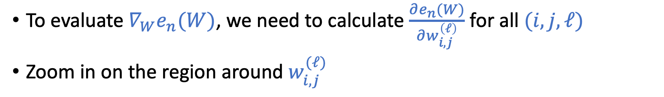

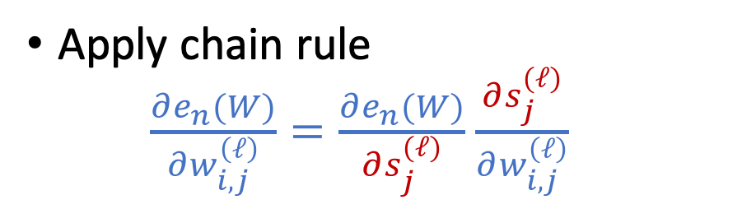
Compute the Gradient $∇_{W}e_{n}(W)$
To evaluate $∇_{W}e_{n}(W)$, we need to calculate $\frac{∂e_{n}(W)}{∂w_{i,j}^{\left(ℓ\right)}}$ for all $(i,j,ℓ)$
Zoom in on the region around $w_{i,j}^{(ℓ)}$
Apply chain rule $\frac{∂e_{n}(W)}{∂w_{i,j}^{\left(ℓ\right)}}=\frac{∂e_{n}(W)}{∂s_{j}^{(ℓ)}}$ $\frac{∂s_{j}^{(ℓ)}}{∂w_{i,j}^{\left(ℓ\right)}}$

Slide 29
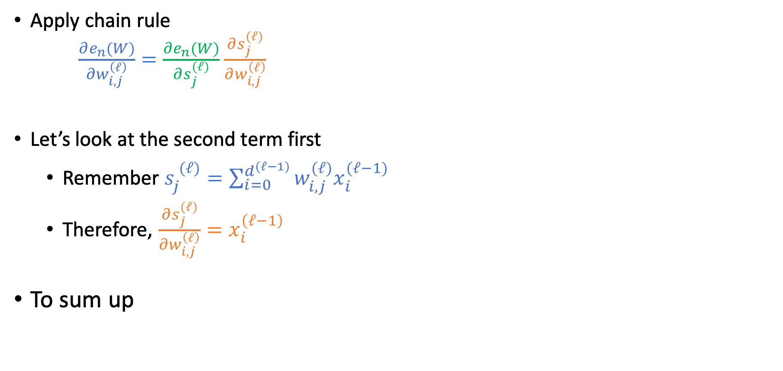
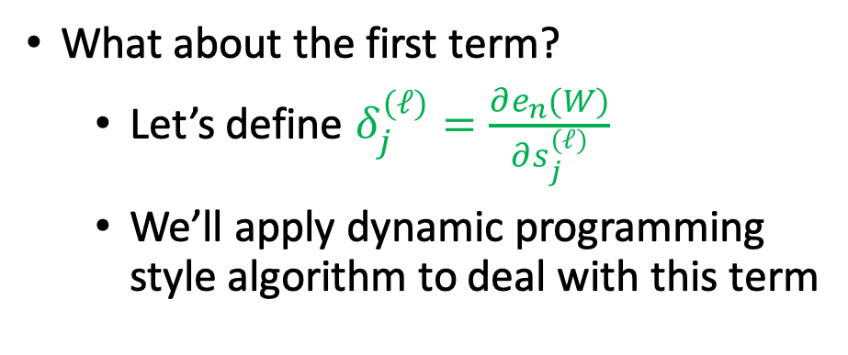
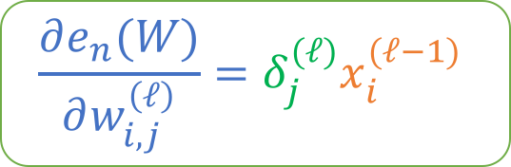
Compute the Gradient $∇_{W}e_{n}(W)$
Apply chain rule $\frac{∂e_{n}(W)}{∂w_{i,j}^{\left(ℓ\right)}}=\frac{∂e_{n}(W)}{∂s_{j}^{(ℓ)}}$ $\frac{∂s_{j}^{(ℓ)}}{∂w_{i,j}^{\left(ℓ\right)}}$
Let’s look at the second term first
Remember $s_{j}^{ (ℓ)}=\sum_{i=0}^{d^{(ℓ−1)}}{w_{i,j}^{(ℓ)}x_{i}^{(ℓ−1)}}$
Therefore, $\frac{∂s_{j}^{(ℓ)}}{∂w_{i,j}^{\left(ℓ\right)}}=x_{i}^{\left(ℓ−1\right)}$
To sum up
What about the first term?
Let’s define $δ_{j}^{(ℓ)}=\frac{∂e_{n}(W)}{∂s_{j}^{(ℓ)}}$
We’ll apply dynamic programming style algorithm to deal with this term
$$\frac{∂e_{n}(W)}{∂w_{i,j}^{\left(ℓ\right)}}=δ_{j}^{(ℓ)}x_{i}^{(ℓ−1)}$$

Slide 30
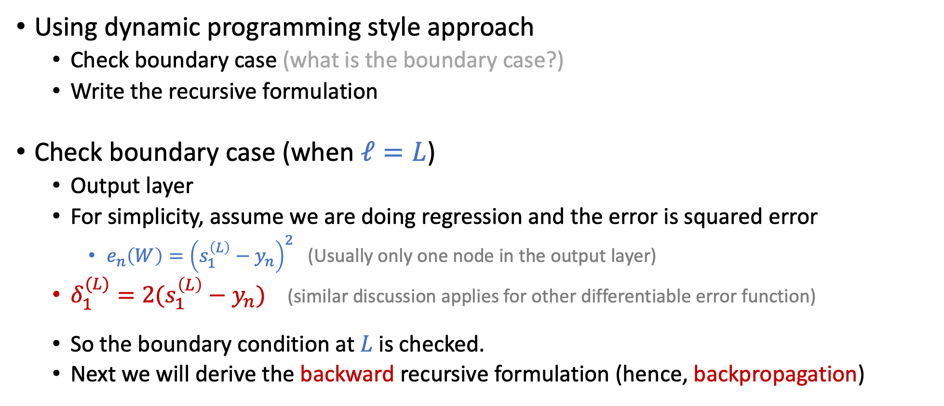

Compute $δ_{j}^{(ℓ)}=\frac{∂e_{n}(W)}{∂s_{j}^{(ℓ)}}$
Using dynamic programming style approach
Check boundary case (what is the boundary case?)
Write the recursive formulation
Check boundary case (when $ℓ=L$)
Output layer
For simplicity, assume we are doing regression and the error is squared error
$e_{n}\left(W\right)={\left(s_{1}^{\left(L\right)}−y_{n}\right)}^{2}$ (Usually only one node in the output layer)
$δ_{1}^{(L)}=2(s_{1}^{\left(L\right)}−y_{n})$ (similar discussion applies for other differentiable error function)
So the boundary condition at $L$is checked.
Next we will derive the backward recursive formulation (hence, backpropagation)

Slide 31

Compute $δ_{j}^{(ℓ)}=\frac{∂e_{n}(W)}{∂s_{j}^{(ℓ)}}$
Zoom in to see the chain of dependencies

Slide 32
Compute $δ_{j}^{(ℓ)}=\frac{∂e_{n}(W)}{∂s_{j}^{(ℓ)}}$
Zoom in to see the chain of dependencies

Slide 33

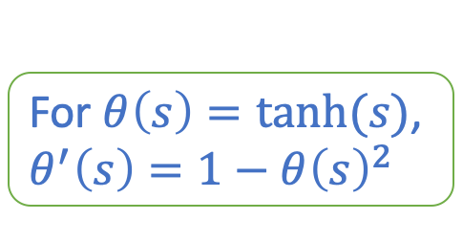
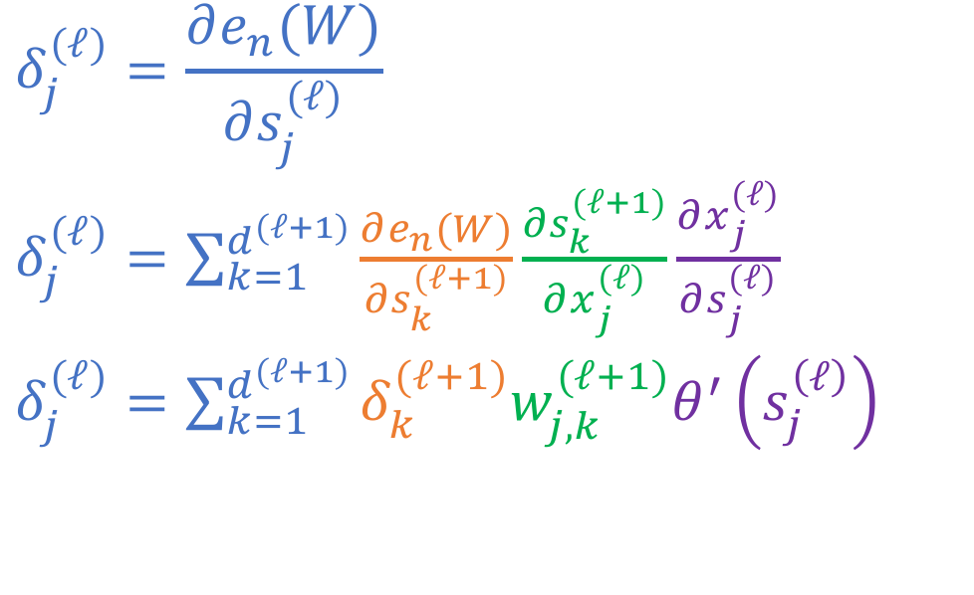
Compute $δ_{j}^{(ℓ)}=\frac{∂e_{n}(W)}{∂s_{j}^{(ℓ)}}$
Zoom in to see the chain of dependencies
For $θ\left(s\right)=tanh⁡(s)$, $θ^{′}\left(s\right)=1−θ{\left(s\right)}^{2}$
$$δ_{j}^{(ℓ)}=\frac{∂e_{n}(W)}{∂s_{j}^{(ℓ)}}$$
$δ_{j}^{(ℓ)}=\sum_{k=1}^{d^{(ℓ+1)}}{\frac{∂e_{n}(W)}{∂s_{k}^{(ℓ+1)}}\frac{∂s_{k}^{(ℓ+1)}}{∂x_{j}^{(ℓ)}}\frac{∂x_{j}^{(ℓ)}}{∂s_{j}^{(ℓ)}}}$
$δ_{j}^{(ℓ)}=\sum_{k=1}^{d^{(ℓ+1)}}{δ_{k}^{(ℓ+1)}w_{j,k}^{(ℓ+1)}θ^{′}\left(s_{j}^{\left(ℓ\right)}\right)}$
We have the backward recurve definition!

Slide 34
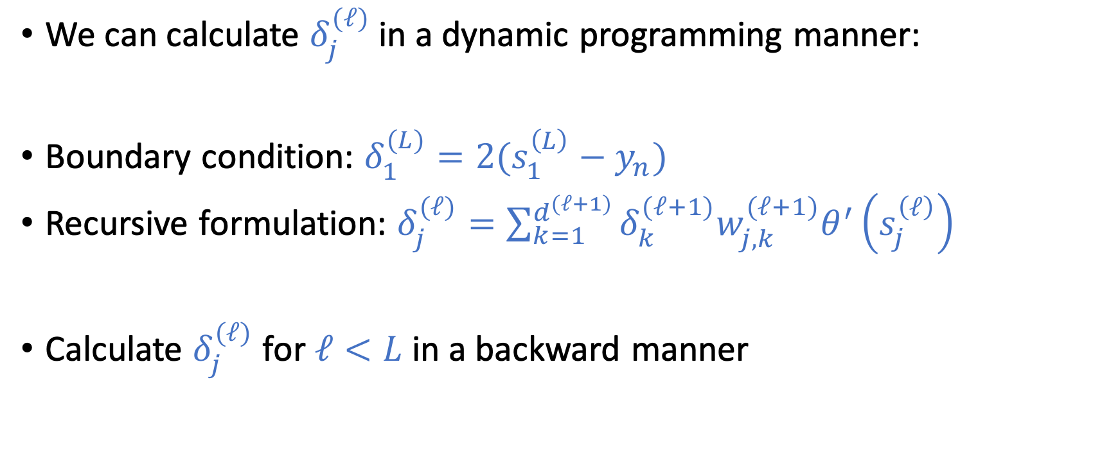
Compute $δ_{j}^{(ℓ)}=\frac{∂e_{n}(W)}{∂s_{j}^{(ℓ)}}$
We can calculate $δ_{j}^{(ℓ)}$ in a dynamic programming manner:
Boundary condition: $δ_{1}^{(L)}=2(s_{1}^{\left(L\right)}−y_{n})$
Recursive formulation: $δ_{j}^{(ℓ)}=\sum_{k=1}^{d^{(ℓ+1)}}{δ_{k}^{(ℓ+1)}w_{j,k}^{(ℓ+1)}θ^{′}\left(s_{j}^{\left(ℓ\right)}\right)}$
Calculate $δ_{j}^{(ℓ)}$ for $ℓ<L$ in a backward manner

Slide 35
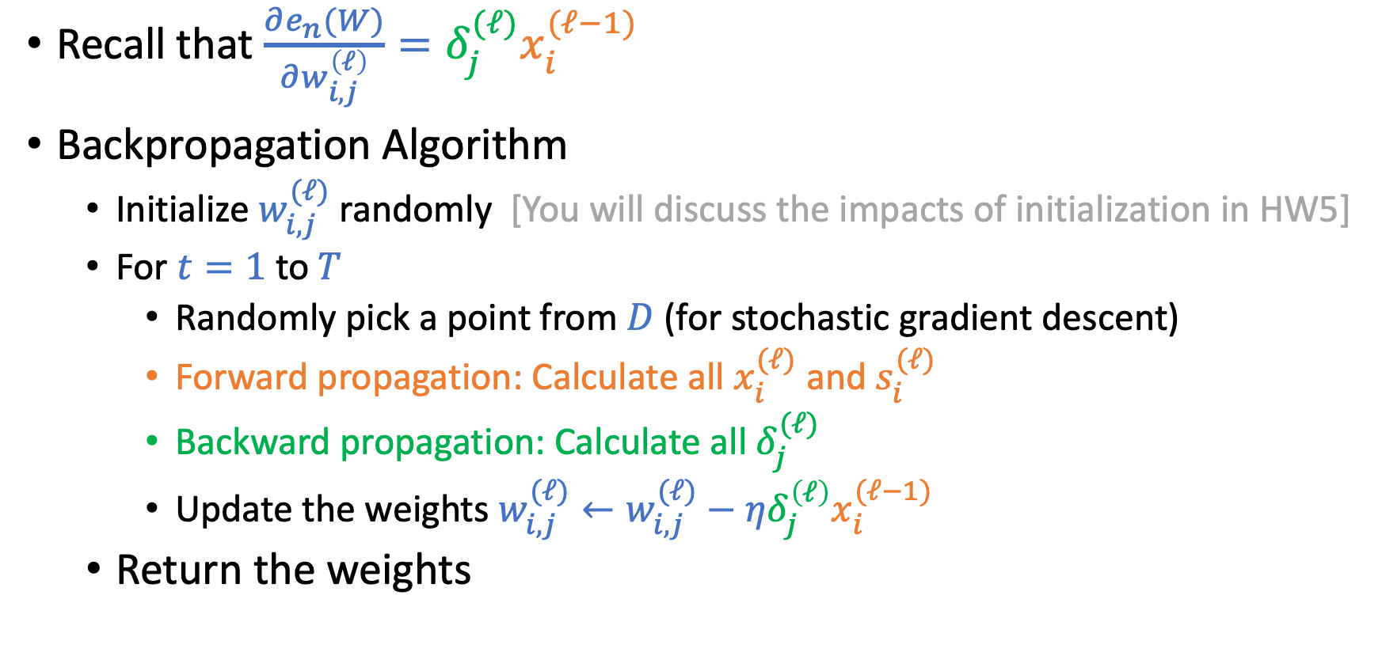
Backpropagation Algorithm
Recall that $\frac{∂e_{n}(W)}{∂w_{i,j}^{\left(ℓ\right)}}=δ_{j}^{(ℓ)}x_{i}^{(ℓ−1)}$
Backpropagation Algorithm
Initialize $w_{i,j}^{(ℓ)}$randomly [You will discuss the impacts of initialization in HW5]
For $t=1$ to $T$
Randomly pick a point from $D$ (for stochastic gradient descent)
Forward propagation: Calculate all $x_{i}^{(ℓ)}$ and $s_{i}^{(ℓ)}$
Backward propagation: Calculate all $δ_{j}^{(ℓ)}$
Update the weights $w_{i,j}^{(ℓ)}←w_{i,j}^{(ℓ)}−η{δ_{j}^{\left(ℓ\right)}x}_{i}^{(ℓ−1)}$
Return the weights

Slide 36
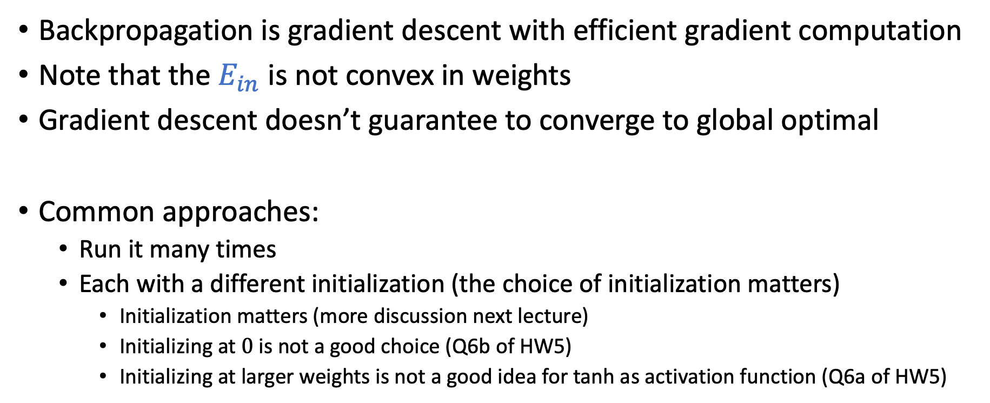
Discussion
Backpropagation is gradient descent with efficient gradient computation
Note that the $E_{in}$ is not convex in weights
Gradient descent doesn’t guarantee to converge to global optimal
Common approaches:
Run it many times
Each with a different initialization (the choice of initialization matters)
Initialization matters (more discussion next lecture)
Initializing at $0$ is not a good choice (Q6b of HW5)
Initializing at larger weights is not a good idea for tanh as activation function (Q6a of HW5)

Slide 37
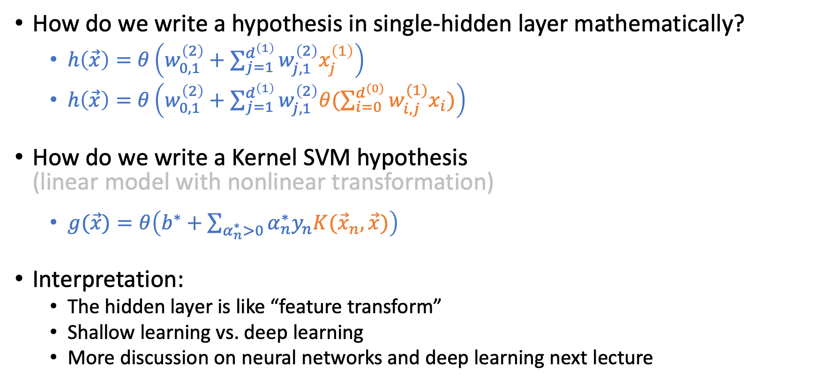
Single Hidden-Layer Neural Network
How do we write a hypothesis in single-hidden layer mathematically?
$h\left(\vec{x}\right)=θ\left(w_{0,1}^{\left(2\right)}+\sum_{j=1}^{d^{\left(1\right)}}{w_{j,1}^{\left(2\right)}x_{j}^{\left(1\right)}}\right)$
$h\left(\vec{x}\right)=θ\left(w_{0,1}^{\left(2\right)}+\sum_{j=1}^{d^{\left(1\right)}}{w_{j,1}^{\left(2\right)}θ(\sum_{i=0}^{d^{(0)}}{w_{i,j}^{(1)}x_{i}})}\right)$
How do we write a Kernel SVM hypothesis (linear model with nonlinear transformation)
$g(\vec{x})=θ\left(b^{∗}+\sum_{α_{n}^{∗}>0}{α_{n}^{∗}y_{n}K({\vec{x}}_{n},\vec{x})}\right)$
Interpretation:
The hidden layer is like “feature transform”
Shallow learning vs. deep learning
More discussion on neural networks and deep learning next lecture

Slide 38
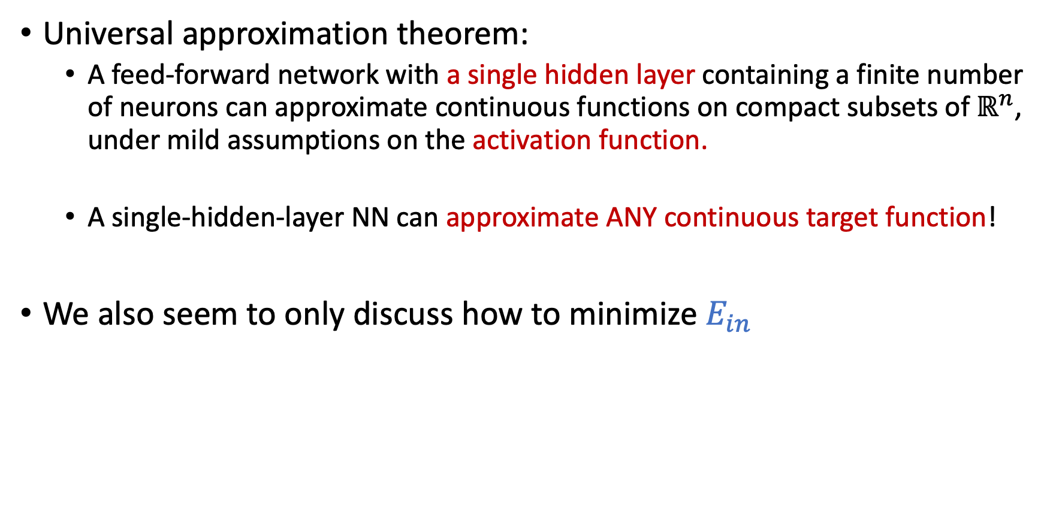
Neural Network is Expressive
Universal approximation theorem:
A feed-forward network with a single hidden layer containing a finite number of neurons can approximate continuous functions on compact subsets of$ℝ^{n}$, under mild assumptions on the activation function.
A single-hidden-layer NN can approximate ANY continuous target function!
We also seem to only discuss how to minimize $E_{in}$
What about overfitting?
Notes:
Activation function – non-constant, bounded, continuous

Slide 39
Regularization in Neural Networks

Slide 40
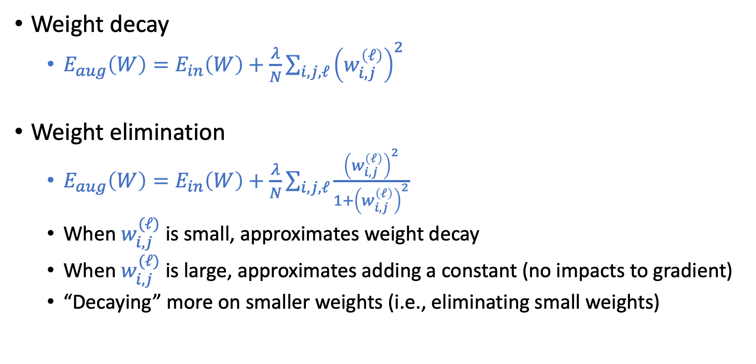
Weight-Based Regularization
Weight decay
$E_{aug}\left(W\right)=E_{in}\left(W\right)+\frac{λ}{N}\sum_{i,j,ℓ}{{\left(w_{i,j}^{\left(ℓ\right)}\right)}^{2}}$
Weight elimination
$E_{aug}\left(W\right)=E_{in}\left(W\right)+\frac{λ}{N}\sum_{i,j,ℓ}{\frac{{\left(w_{i,j}^{\left(ℓ\right)}\right)}^{2}}{1+{\left(w_{i,j}^{\left(ℓ\right)}\right)}^{2}}}$
When $w_{i,j}^{(ℓ)}$ is small, approximates weight decay
When $w_{i,j}^{(ℓ)}$ is large, approximates adding a constant (no impacts to gradient)
“Decaying” more on smaller weights (i.e., eliminating small weights)

Slide 41
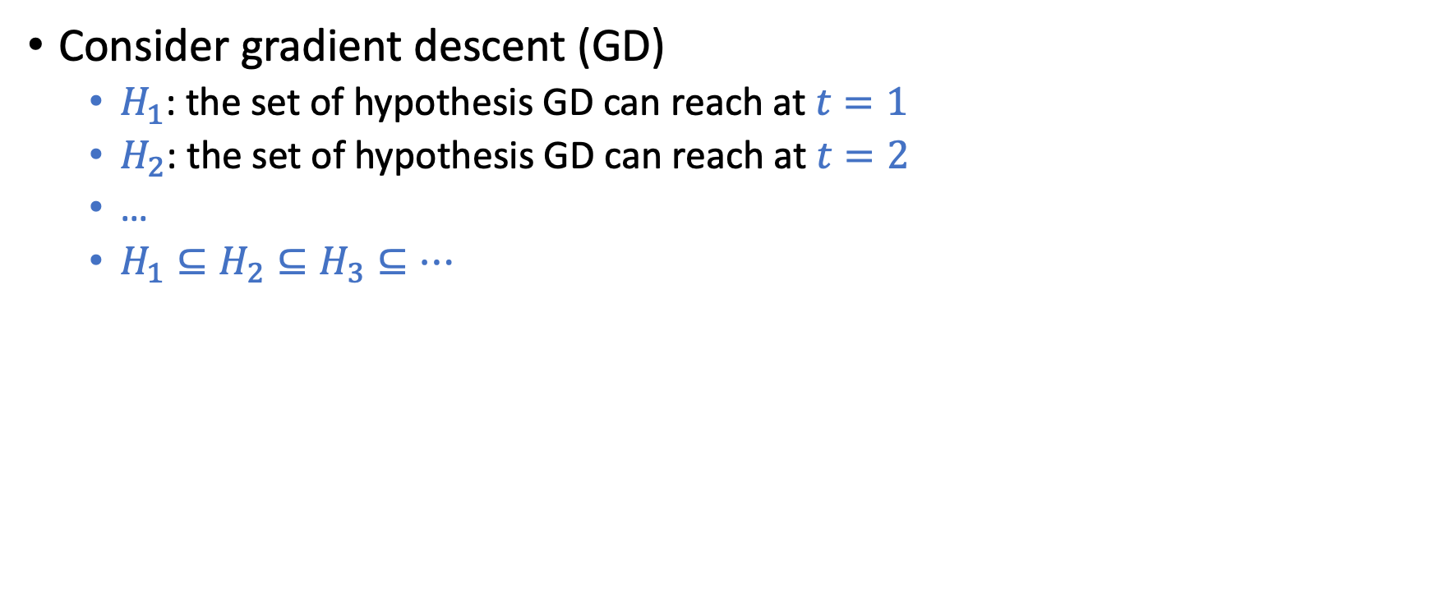
Early Stopping
Consider gradient descent (GD)
$H_{1}$: the set of hypothesis GD can reach at $t=1$
$H_{2}\text{: }\text{the} \text{set} \text{of} \text{hypothesis} \text{GD} \text{can} \text{reach} \text{at} t=2$
…
$H_{1}⊆H_{2}⊆H_{3}⊆…$

Slide 42
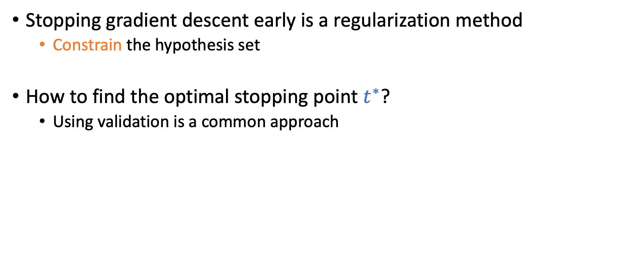
Early Stopping
Stopping gradient descent early is a regularization method
Constrain the hypothesis set
How to find the optimal stopping point $t^{∗}$?
Using validation is a common approach

Slide 43
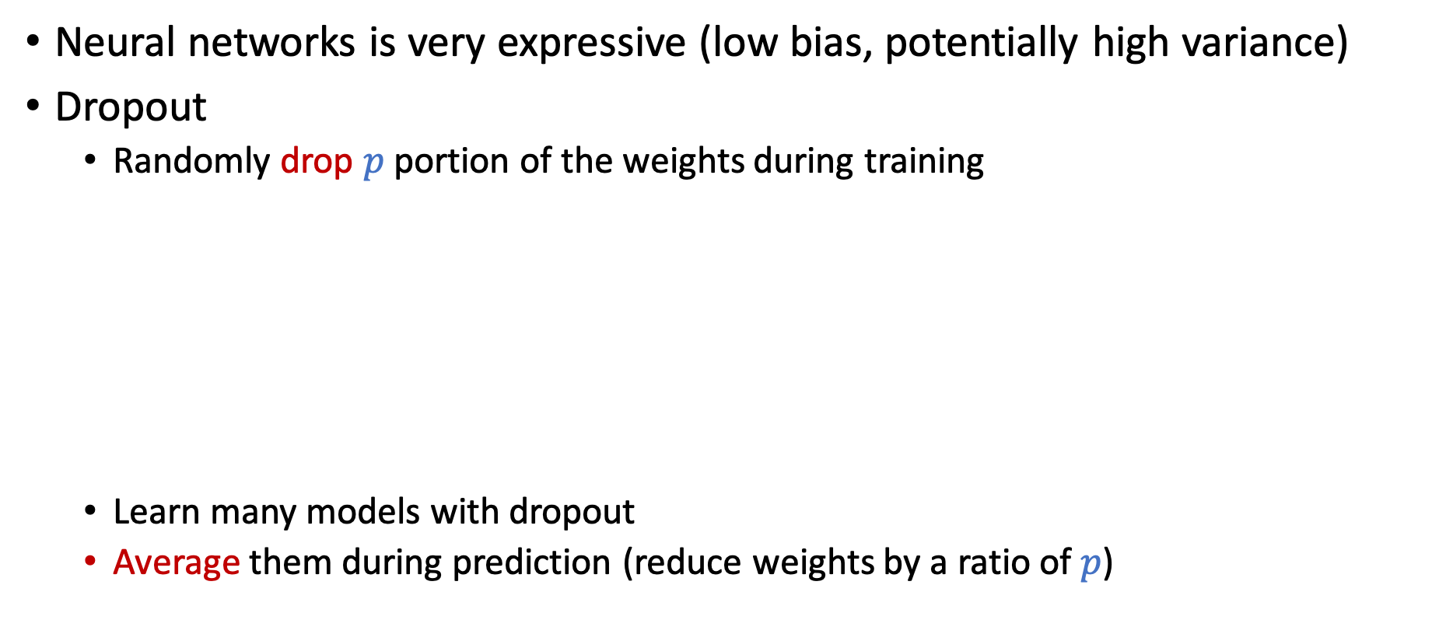
Dropout
Neural networks is very expressive (low bias, potentially high variance)
Dropout
Randomly drop $p$portion of the weights during training
Learn many models with dropout
Average them during prediction (reduce weights by a ratio of $p$)

Slide 44
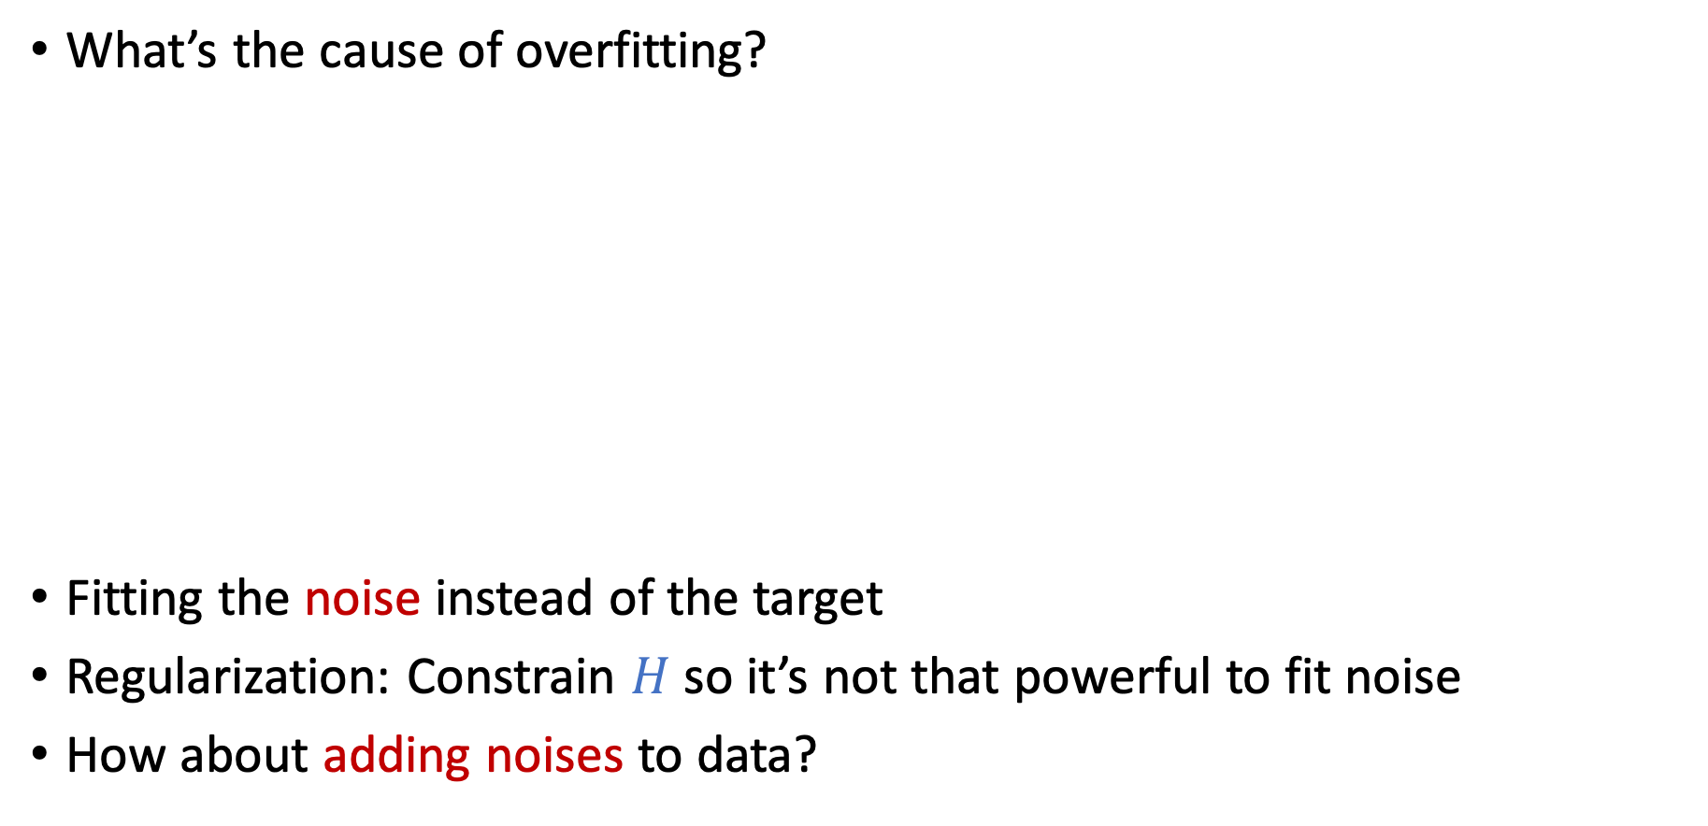
A Nontraditional Method to Avoid Overfitting
What’s the cause of overfitting?
Fitting the noise instead of the target
Regularization: Constrain $H$ so it’s not that powerful to fit noise
How about adding noises to data?

Slide 45
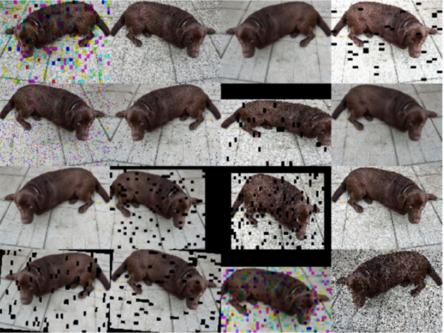

Adding Noises as Regularization
Notes:
Data augmentation

Slide 46
Initialization

Slide 47

Error is Nonconvex in Neural Networks
We mostly adopt gradient-descent-style algorithms for optimization.
No guarantee to converge to global optimal.
Need to run it many times.
Initialization matters!

Slide 48
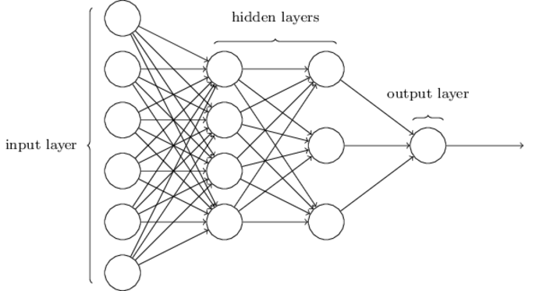
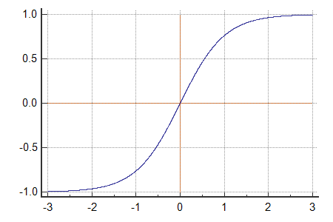
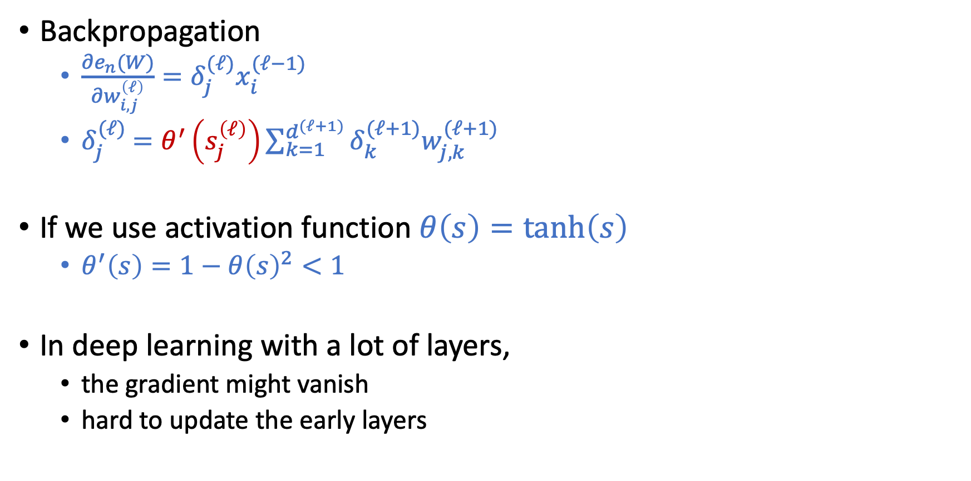
Vanishing Gradient Problem
Backpropagation
$\frac{∂e_{n}(W)}{∂w_{i,j}^{\left(ℓ\right)}}=δ_{j}^{(ℓ)}x_{i}^{(ℓ−1)}$
$δ_{j}^{(ℓ)}$ $=θ^{′}\left(s_{j}^{\left(ℓ\right)}\right)\sum_{k=1}^{d^{(ℓ+1)}}{δ_{k}^{(ℓ+1)}w_{j,k}^{(ℓ+1)}}$
If we use activation function $θ\left(s\right)=\tanh\left(s\right)$
$θ^{′}\left(s\right)=1−θ{\left(s\right)}^{2}<1$
In deep learning with a lot of layers,
the gradient might vanish
hard to update the early layers

Slide 49


Vanishing Gradient Problem
$δ_{j}^{(ℓ)}$ $=θ^{′}\left(s_{j}^{\left(ℓ\right)}\right)\sum_{k=1}^{d^{(ℓ+1)}}{δ_{k}^{(ℓ+1)}w_{j,k}^{(ℓ+1)}}$
There is also a corresponding “exploding gradient problem”
What can we do
Choose more suitable activation functions
One common choice is Rectified Linear Unit (ReLU) and its variant
$θ\left(s\right)=max⁡(0,s)$
Choose better initialization
Many approaches

Slide 50
Weight Initialization
Initializing weights to 0 is a bad idea
Q5 of HW1
Randomly Initializing weights to regions so that vanishing/exploding gradients are less likely to happen
Activation-function dependent
e.g., Xavier initialization for tanh
Learning the initialization
E.g., autoencoder

Slide 51
Initialization
Hard to initialize the entire network well.
Intuition: Initialize the weights layer by layer such that each layer preserves the properties of the previous layer.

Slide 52

Autoencoder
Unsupervised learning!
https://www.meetup.com/Le-Mans-School-of-AI/photos/29159837/477498782/

